Slide 1

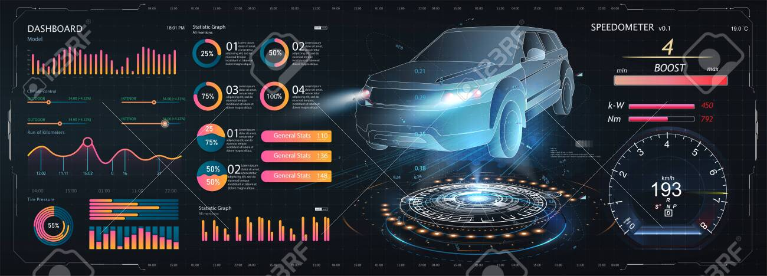
Analysis on Cars24.com
Done by:
MOHAMMED GUFRAN
MD.MOBASSIR HASSAN

Slide 2



Objective:
we aims to understand the strong relationship of used cars.
A car24 company use this case study to ensure that the costumer capable of knowing the knowledge of the used cars
The result of this cars analysis would help the customer to identify the models of cars , which indicate if a customer has difficulty to find best car on the basis of features and prices..
be able to decide whether a used car is right for you, decide whether buying is right for you or not, Understand the hidden costs of operation and maintenance of cars.

Slide 3

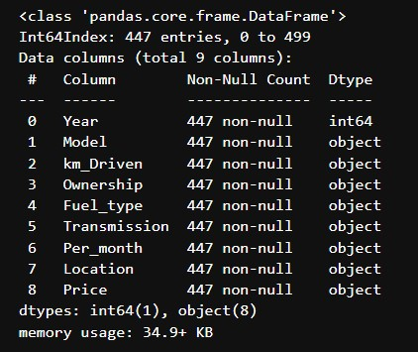
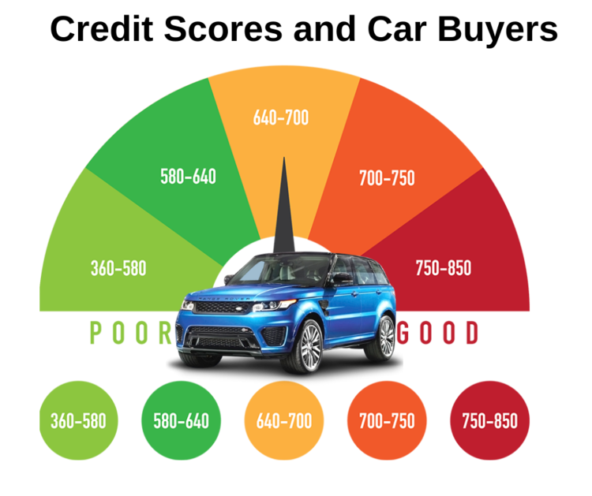

Slide 4

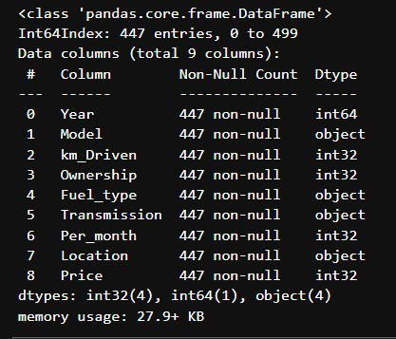
Before Cleaning
After Cleaning

Slide 5

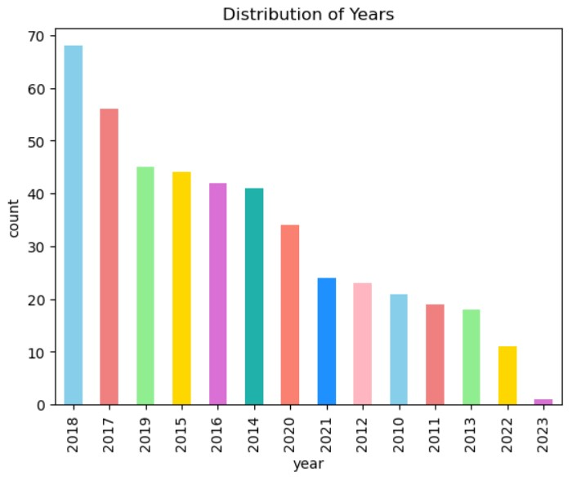
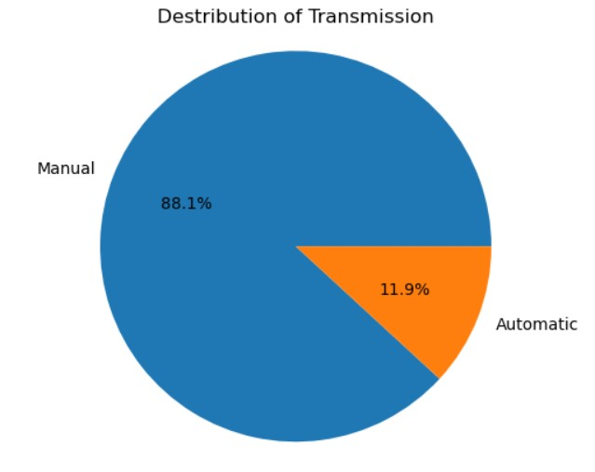
Analysis on Years:
Here we can observe that in year count plot highest number of car is from 2018 to 2014 and lowest in 2021 to 2023
In fuel type we can see that Manual is 88.1% and Automatic is 11.9%

Slide 6
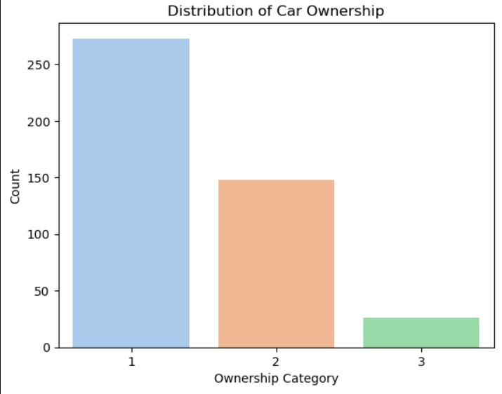
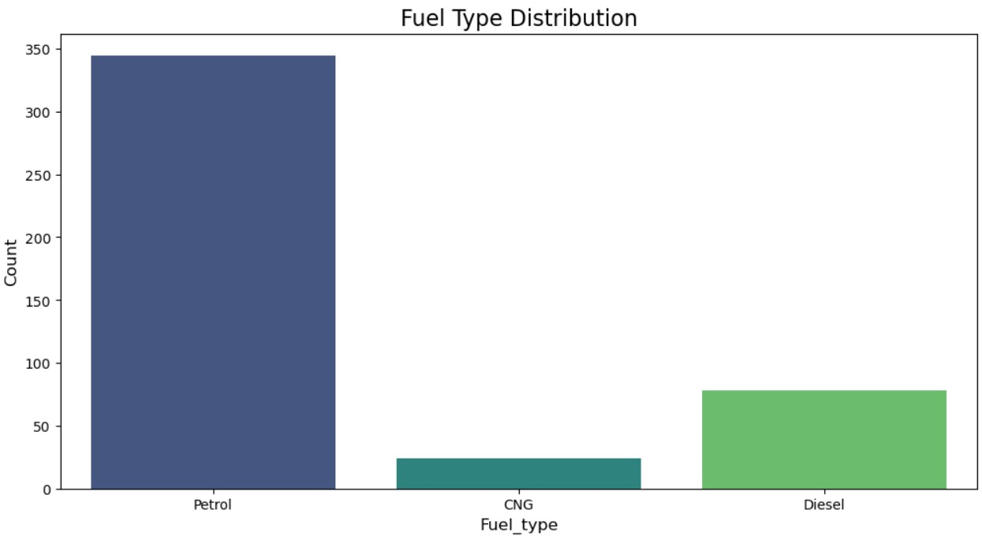
Analysis on Person_ownership:
Analysis on fuel type:
Highest count ownership is 1st, as compare to the 2nd & 3rd ownership of the cars
In the car's Fuel type the higher number of cars is in Petrol, and then Diesel & CNG.

Slide 7
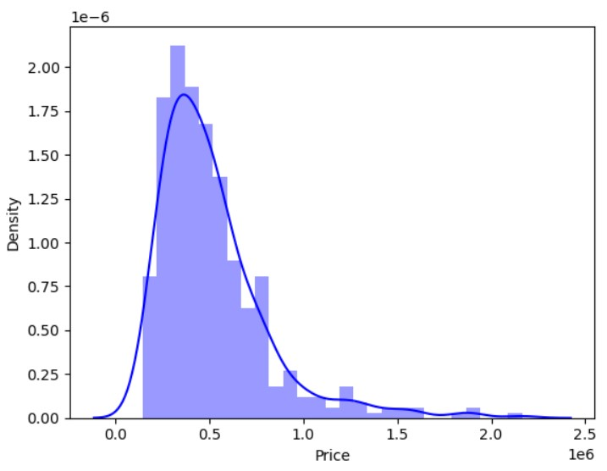
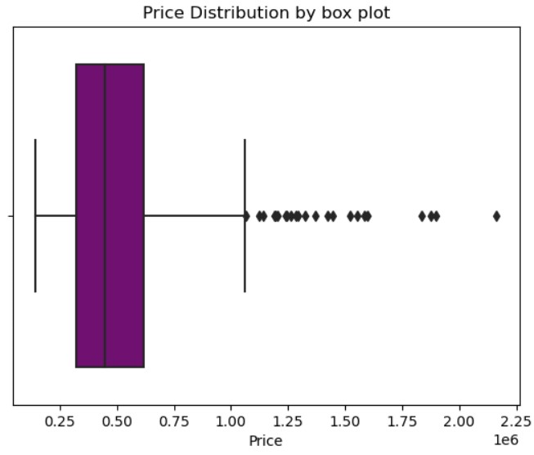

Analysis on Price
Price is not normal distribution, and the values are in price is higher from 3.4 lakh to 5 lakh
Outliers are getting in a price feature starting from 10 lakh to 20 L

Slide 8
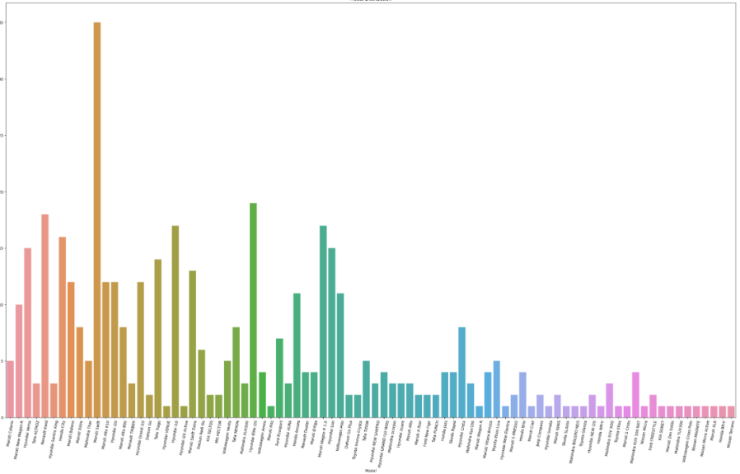
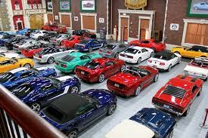
Analysis on models
Highest number of used car is maruti swift car are present in india

Slide 9
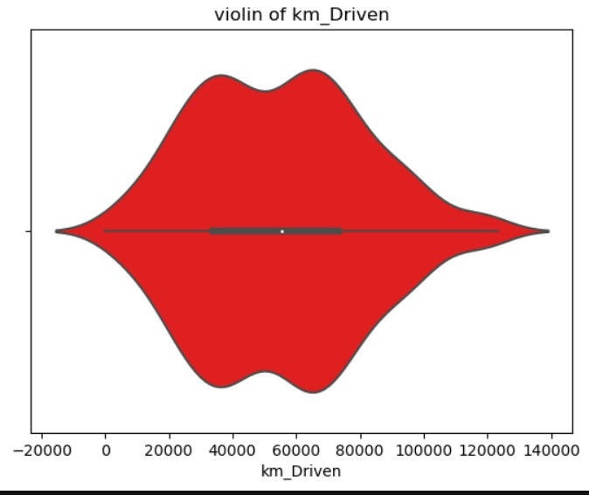
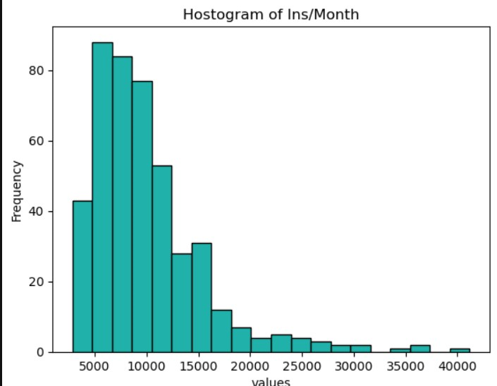
Analysis on Km Driven &per/months:
In this violin plot of km driven is not normal distribution
Highest EMI is starting from 5000 to 12k

Slide 10
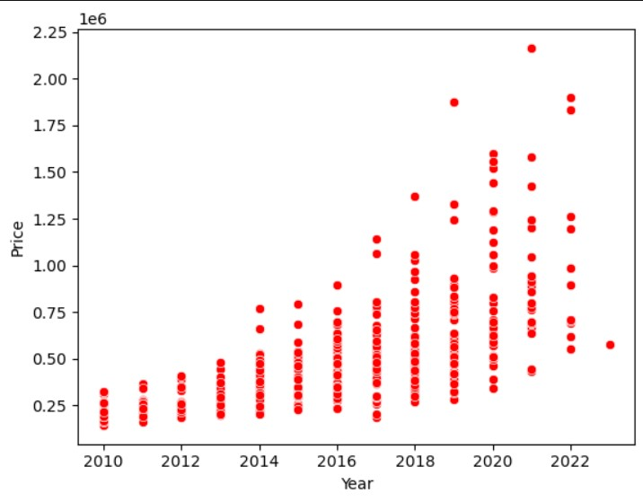
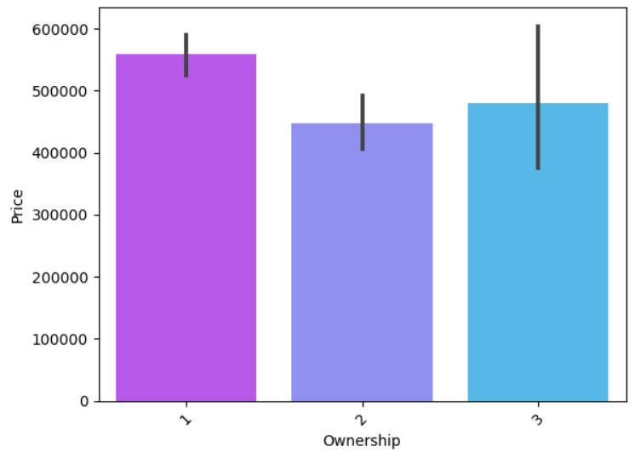
Relation blw year and price & Owner and price
As year increases and the price of car is also increases.
Rate of 1st owner of car is high

Slide 11
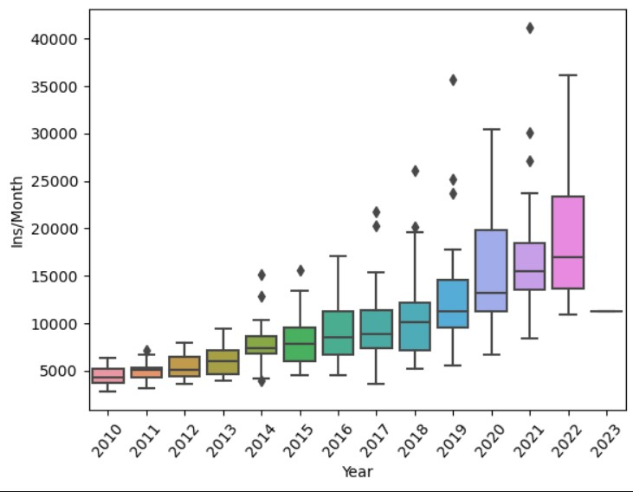
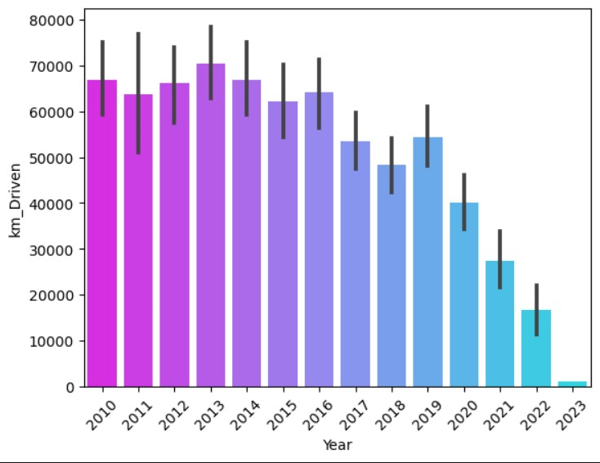
Relationship b|w Year and EMI , Year and km Driven
As year increases EMI also increases and we see some outliers also
In this plot we can observe New model of car is less Kilometer Driven compare to old one’s

Slide 12
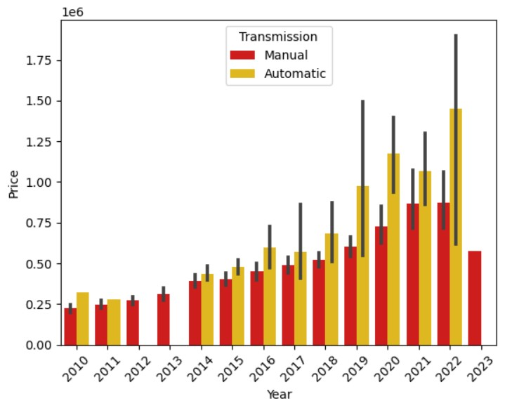
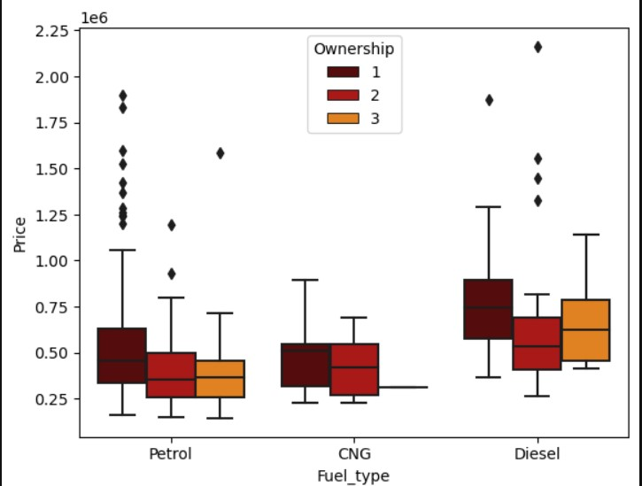
Relation blw year, price and transmission :
Relationship b|w Price , Fuel type and ownership
By year price increasing and it’s transmission of automatic is also increasing in a new model of cars
In this plot we can see that based on the Ownership and Fuel type the Price is changing

Slide 13
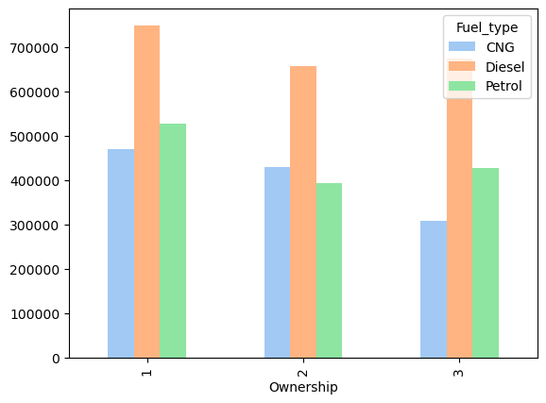
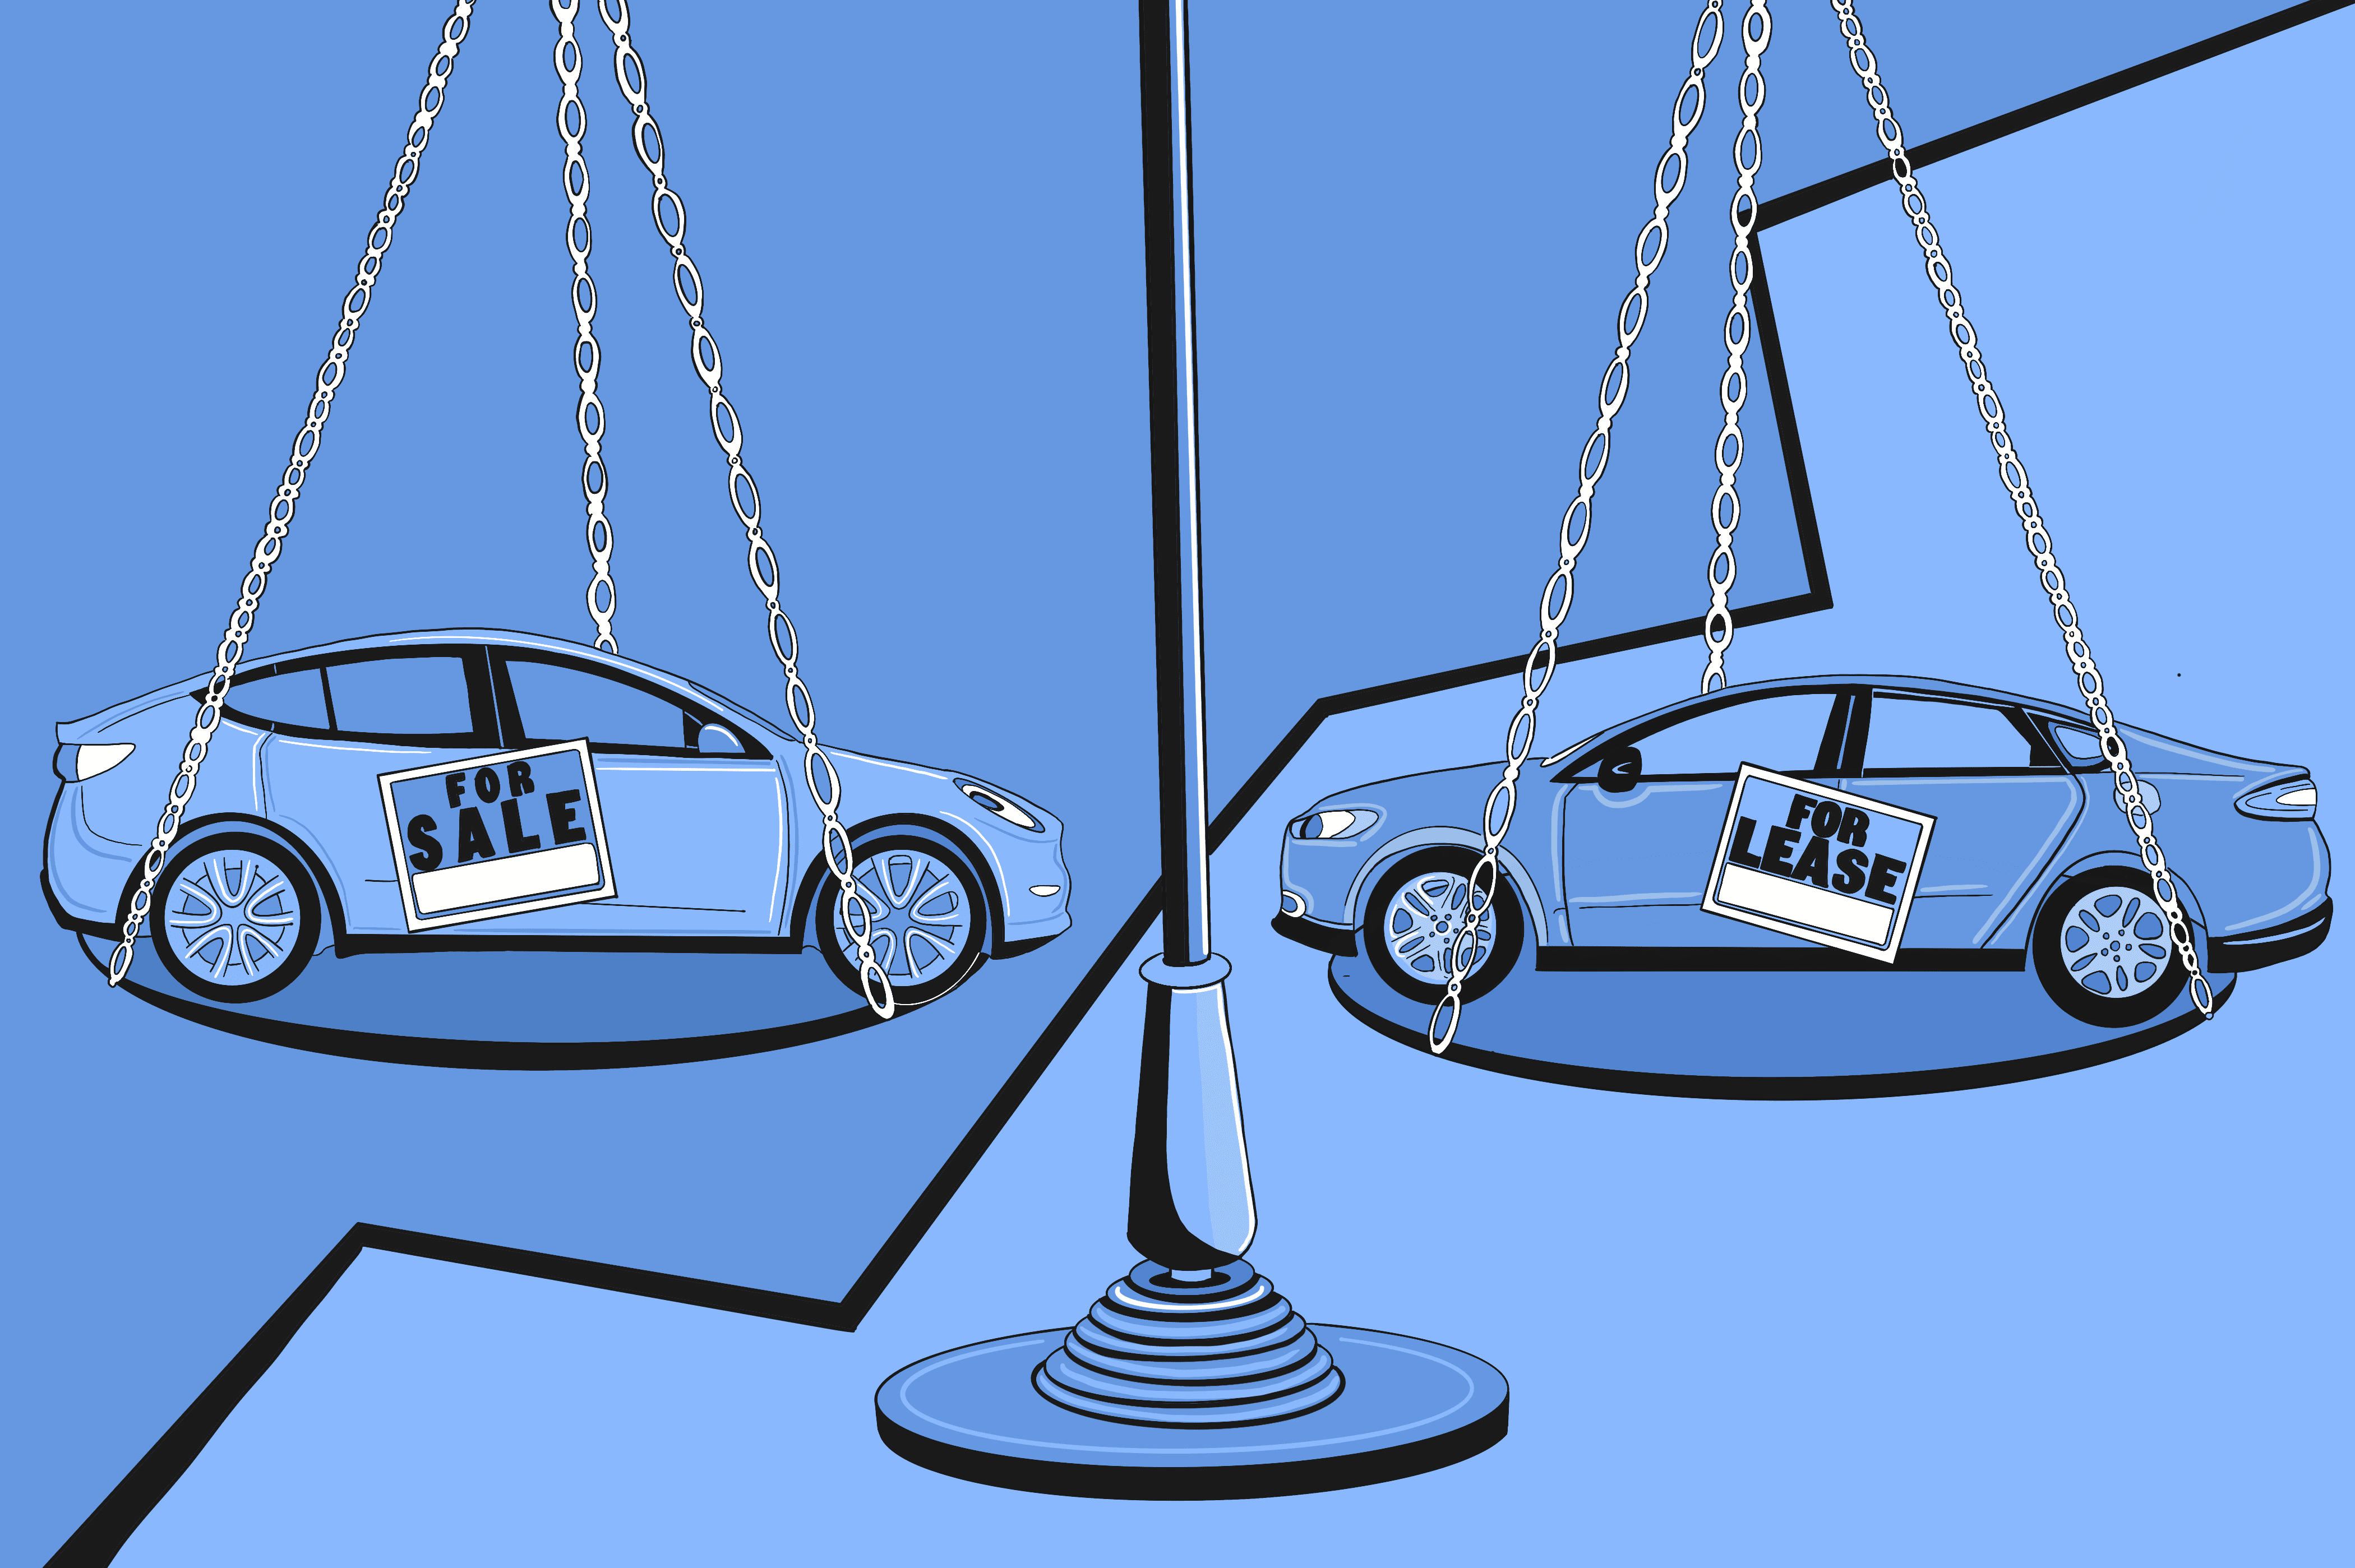
Relationship b|w owner ship and fuel type with value price
In this plot we are know about the average of the price with the others features that is Fuel type and Ownership of the cars

Slide 14
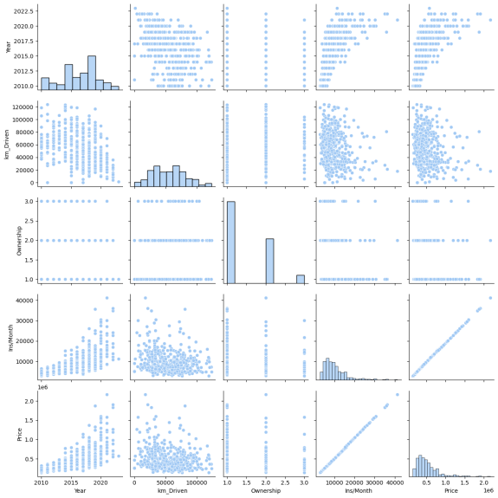
Cor Relationship:

Slide 15
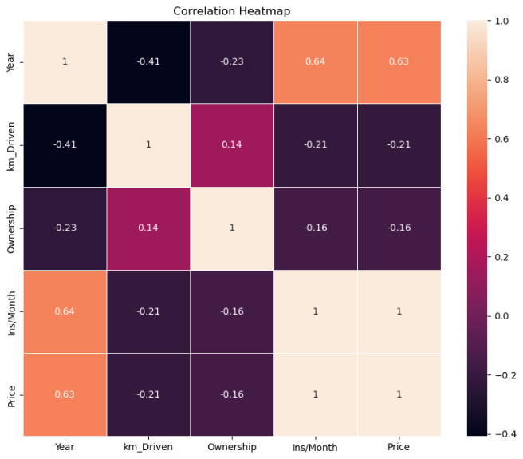
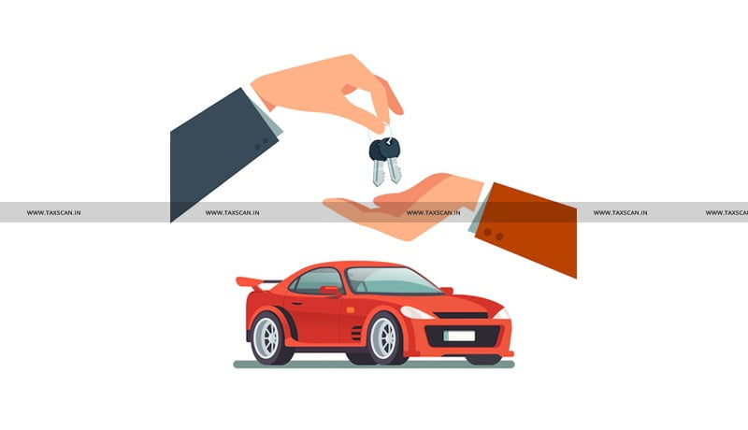
Correlation ship of heat map
Heat map show the correlation ship between all the numerical features in this heat we can observe that between two features i.e Price and emi strongly co related

Slide 16

Price Comparison: buyers to easily compare prices and features of different used cars. This transparency can help buyers make informed decisions and find the best deals.
Used cars are generally more affordable than new cars because they have already experienced significant depreciation. New cars typically lose value quickly in the first few years.
The used car market offers a wide variety of makes, models, and years. This diversity allows buyers to find a vehicle that suits their needs and preferences.
Look into the long-term ownership costs of the specific vehicle, including fuel efficiency, insurance rates, and potential costs.

Slide 17


Estimate ongoing ownership costs, including fuel efficiency, insurance rates, and potential repair expenses. These costs can vary by make and model.
Contact your insurance provider to get an estimate of insurance costs for the specific make and model you're considering.
S
Think about the car's fuel efficiency, especially if you have specific mileage requirements or want to reduce your environmental footprint.
Ask the seller about the car's ownership history. Understanding how many previous owners the car has had can provide insights into how well it has been maintained.

Slide 18

Finding filling values and fixing them
Scraping data from car 24 website
Finding duplicates and dropping them
Understanding Columns

Slide 19

Any Questions About The Project

Slide 20


THANK YOU

